Slide 1
Municipal Reference Model for Smarter Cities
Alison Oleksiak, DE, S&D Provincial Government, Health and Education
Jim Amsden, STSM, Solution Architect, Unleash the Labs
January 11, 2011
Notes:
This is a summary of the MRM, its origin, goals, future vision and tooling support in order to foster a broader understanding of what MRM is, and how it can be used as an industry asset for Smarter Cities.
MRM supports an architectural description of municipal enterprises that can be exploited for strategic planning, and in promoting their use of BI, BPM, SOA, and Systems Engineering models and methods. It represents reusable IC around EA and System-of-System industry models for Smart Cities.
MRM is focused on the business strategy part of municipal government. It provides the foundation for guiding municipalities in their transition initiatives as they address shrinking revenues, increased community needs, and increased political pressure.
Other aspects of Smarter Cities can compliment MRM by providing application and technology platforms that enable automation and monitoring of activities required to deliver program services. Then business intelligence can be used on the information collected to close the loop, providing valuable, objective information that contributes to further strategic planning and design.

Slide 2
Agenda
Municipal Business Challenges
Leveraging Municipal Reference Models to address Business Challenges
Review revised MRM V2 Model
MISA Delivery Platform
Governance and Role review
Supporting Tools
How MRM fits with other Smarter Cities Initiatives
Next Steps

Slide 3
Municipal Reference Model
Brief History…..
1990: Established Joint Venture of 20+ Ontario municipalities to develop Municipal Reference Model and Engineering Database – initially as a data model
1992: JV Awards RFP to develop and administer MRM program to Chartwell IRM (Chartwell acquired by KPMG in 2009)
1995-2000: MRM evolves from a data to a business model and is successfully marketed by Chartwell to other Canadian, US and overseas municipalities
2000-2008: MRM adopted and adapted by Province of Ontario (PSRM) and Government of Canada (GSRM); integrated into business transformation enablement process (BTEP)
2007-: MRMv2 Project undertaken by MISA/ASIM Canada to update and re-establish MRM at municipal level and align with PSRM/GSRM
Notes:
3
Background

Slide 4
The challenge of Government... Local, State, Federal all have the same challenges…
Why does our business exist?
How many programs and services do we provide?
Why do we provide those services and not others?
Who is accountable for which services?
Are there duplicate services?
How much do we spend to deliver those services?
Where is there conflicting accountability? Or no accountability?
What program outcomes are we trying to achieve? How are we doing?
Are the services contributing to the desired program outcomes?
What are our service outputs? Who are the clients?
How do we measure our success at the program level? At the service level? At the process level?
What can be improved? Where should we focus our improvement efforts?
What are all the services that we provide to a given target group (e.g. seniors, youth, aboriginals)?
What about horizontal portfolios (departmental, intra- or inter- government)?
Simple Questions... ... Tough to Answer!
Government is complex. Change is hard! Integrated change is even harder!!

Slide 5
Objectives - Coherent Government by design
If we really want:
to move to a “whole of government” approach,
seamless, citizen-centred services,
legislation, regulations and policies designed rather than crafted,
alignment, integration, interoperability, etc. in our business systems,
to do more with less
We really need:
a consistent and more formal business design capability based on a common language and set of rules for using it to create better descriptions of what we want (e.g. more coherent ones). A pan-Canadian standard along these lines will enable any conceivable government line-of-business (and inter-collaborations thereof) to better:
interpret and clarify their missions, strategies, outcomes, etc.
accurately depict or map how they work (and how they can work together),
discover opportunities for business improvements,
support their planning and successful implementation.

Slide 6





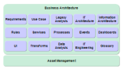
Evolve from paper-based to semantically rich tools
Before
Defaults to Paper
Assets
Business & Users
Implementation
Pictures & Documents
Fund
Hand off
Requirements
Governed
Confusion
Leverage
tools aligned
to a Roles
usability
& integration
needs
After
Business & Users
Business Architecture
Implementation
Impact Analysis
Fund
Publish
Requirements
Governed,
Managed Assets
Acceleration!
Code, Scripts,
Traceability,
Accuracy
Instrumented (KPIs) Interconnected (traceability) Intelligent (acceleration!)

Slide 7
The Municipal Reference Model Version 2 (MRM v2)
MRM v2 Goal: to create a Tool (Product, Service) that will help municipal governments describe their vision, goals, objectives, programs, services and performance metrics.
…in a standard way
…using precise definitions and concepts accepted and adopted by all governments in Canada
…with tools and templates to help you create the descriptions of the municipality
…with user guides and training material to help create and use these descriptions for a range of municipal purposes
…with a repository where these descriptions can be saved
…repository pre-populated with a generic set of service descriptions that may be provided to any municipality in Canada
…repository pre-populated with specific descriptions (models) created by other municipalities
…with tools that allow for the analysis and comparison of such descriptions
…and with a collaboration space that allows ideas to be shared on how these tools are being used in participating municipalities
In short: A powerful Authoritative Service Catalogue aligned to an Authoritative Meta Model that all Municipalities can use and share.

Slide 8
Model Driven Business / IT Strategy and Design
(Re-) Use & Develop Models
Business
Drivers
Business User
Business Analyst
Service Analyst
Resource Planner
IBM Industry
Models
Define Project Scope
Analyze Program
Analyze Services
Analyze Processes
Analyze Resources
Analyze Goals & Objectives
Analyze Capabilities
Supporting Services
Strategic Planning
Govern & Manage Enterprise Model Development
Propagate Reference Models
(Re-) Use & Develop Models
Harvest Project Models
Identify and Validate Changes
Version Municipal Models
Model
Manager
Govern & Manage Enterprise Model Assets
Asset
Manager
Govern & Manage Model Development
Promote Enterprise Model
Publish Model Assets
Publish Derivative Assets

Slide 9











ITR validated and further detailed the functional roles that will develop use of the MRMv2 definitions and measures in each municipality, based on a common metamodel and definitions
Information Technology
Budgeting & Finance
Workforce/ HR
Mission Performance
Financial Performance
Operational Performance
Executive Management
Supply Chain
Operations/ Readiness
Services Delivery
Program Execution
Notes:
9

Slide 10
ITR surfaced additional needs for measurement and reporting, and stronger ties between program and service planning with operational management and analysis
1
Business Intelligence
2
Financial Performance & Strategy Management
3
Advanced Analytics
4
Analytic Applications
Monitoring & measuring mission performance to ensure the best outcomes.
Financial and operational performance tied to attaining mission objectives.
Predictive models, forecasting & “what-if” scenarios for refining finance and operations to deliver mission objectives.
Analytic applications developed for specific functions to better manage mission outcomes.
Supply Chain Analytics
Workforce Analytics
Financial Performance Analytics
Planning
What-If Scenarios
Forecasting
Predictive Analytics
Financial Reporting
Financial Analysis
Operational & Financial Risk Management
Scorecards
Reporting
Analysis
Senior Executive Level, Managers
Office of Finance, Program Offices
Office of Finance, Program Offices, Administration
Specific Roles (HR, Supply Chain, Finance, Logistics)

Slide 11


ITR recommendation: Measurement and supporting functionality is available out-of-the-box with products superior to writing scripts that will later require maintenance effort
1
Business Intelligence
2
Financial Performance & Strategy Management
3
Advanced Analytics
4
Analytic Applications
Monitoring & measuring mission performance to ensure the best outcomes.
Financial and operational performance tied to attaining mission objectives.
Predictive models, forecasting & “what-if” scenarios for refining finance and operations to deliver mission objectives.
Analytic applications developed for specific functions to better manage mission outcomes.
Municipal Executive Dashboard
CFO Dashboard for Government
Municipal Performance Scorecard
Rational
Focal Point/Insight
Rational
Focal Point/Insight
Analytic Applications for Government
Senior Executive Level, Managers
Office of Finance, Program Offices
Office of Finance, Program Offices, Administration
Specific Roles (HR, Supply Chain, Finance, Logistics)
Note – Rational Insight, Rational FocalPoint and Cognos already integrated with Rational tools. Request to investigate whether other BI/Dashboard/Analytics tools integrated (e.g. BusinessObjects)

Slide 12
IBM to productizing industry model plug-ins that enable tool integration in a seamless fashion
IBM Rational Modeling Tools
MRM V2
MRM Reference Model
(i.e. Public Safety Program, Fire Rescue Service, etc.)
Rational
System
Architect
MRM Meta-Model
(i.e. Shell Program, Shell Service, etc.)
Proposed Industry Model Plug In
IBM BI, Analytics and Dashboard
COGNOS
SPSS

Slide 13
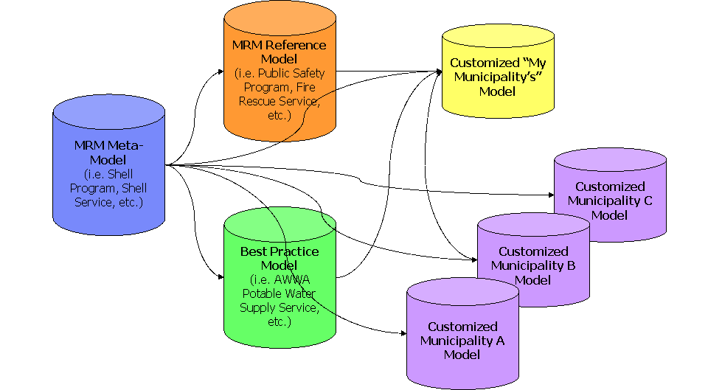
Additional investigation is required to generalize plug-in requirements to support municipal programs and services
MRM v2 Components:
Note – MISA Team has launched a project to review and simplify the Meta Model. Also discussions underway to align with the CGRM project. Will need to agree to a date when the Meta Model deemed as “authoritative” to be used for the pilot.

Slide 14
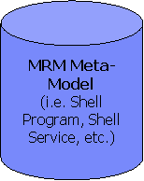
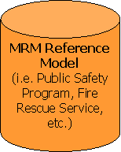
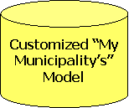
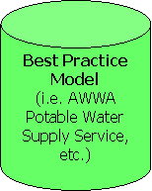
MISA Delivery Platform Governance and Operations
Governance (MRM and Delivery Platform)
Subscriber (Municipalities) Lifecycle Management
Collaboration
Workspace
Design & Modeling Tool Provision
(Image & License Mngt)
Search, Query, Reporting, Import & Export Capabilities
Application & Infrastructure Delivery Platform & Operations (eSolutions)
Municipality Platform Governance and Operations
My Municipality Model Management
Administration
Project
Support
Arch & Model
Review Board
Meta
Modeler
Reference
Modeler
Strategy & Planning
IT Architecture
& Design
Business Operations
Organization &
Process Optimization
Strategic
Intent & Priority
Business
Architecture
Enterprise
Architecture
Executive
Dashboard
BI & Analytics
Organization
Modeling
Application/
Service
Architecture
Technical
Architecture
Solution
Architectures
Mission
Performance
Financial
Performance
Process
Modeling
Transition &
Roadmap
Build &
Test
Operational
Performance
Process
Simulation
Municipality Collaboration, Design & Content Mngt Platforms

Slide 15
MRMv2 Program PROJECT Organization and Governance Structure to be revised to support the go forward role of MISA as a provider of MRM v2 and Collaboration Workspace
MISA / ASIM Canada
MISA Ontario
Steering Committee
NOTE: Chartwell Acquired by KPMG in March 2009
Program Director
Program Advisor
Chartwell
MRM V2 – Program
Program Manager
Design Review Group
Software and Website
Program
Fund Raising
Program Sustainment
Marketing & Communications
Training
Implementation
Lead Municipality
Project Manager
Project Manager
Project Manager
Project Manager
Operating and Support Environment.
Data Population
Software Vendor
Chartwell
Test Municipalities
Project Manager
Project Manager
Note – MISA has a project underway to evaluate the governance model for the future .

Slide 16
MRM Meta-model and Tool Support

Slide 17
Government Reference Model Components An Organizing Framework
Government Reference Models Provide: A Common Language and Structure for Describing the business of Government.

Slide 18
Government Reference Model Components A Service-Based View of Government
VISION /
MISSION
COUNCIL
Viewing government from the outside in - as our clients see us
ROLES
COMMITTEE
OF COUNCIL
PROGRAM
(GOAL)
Governance
WHY?
CAO / CITY
MANAGER
SERVICE MODEL
SERVICE
CLIENT
SET
PUBLIC
SERVICE
WHAT?
INTERNAL
SERVICE
Accountability
DEPT.
1
DEPT.
2
DEPT.
3
FOR WHOM?
BY WHOM?
HOW?
DIVISION
1
DIVISION
2
DIVISION
3
PROCESS /
ACTIVITY
Responsibility
RESOURCE
SECTION
1
SECTION
2
Authority
ORGANIZATIONAL MODEL

Slide 19
A reference model formalizes common vocabulary, methods, and reusable artifacts
Defining our Services – Do we know what services we provide? Are they core to our business? What value are they offering? Are we offering the right Services?
Improving our Services – What is the cost of our services? How do we compare with other governments? Can we improve our efficiency, effectiveness and quality?
Service Levels – What is our current Service Level? How was it determined? What are the cost and service implications if we raise or lower Service Levels?
Service Accountability – Who is accountable for which Services? Is the allocation correct or does it need to be adjusted?
Alternate Service Delivery – Can we outsource, in-source, privatize or contract out all or a portion of our Services?
Service Operations – How do we deliver a service? Are there better ways? What can we learn from others?

Slide 20
Government Reference Model Components A Standard Vocabulary
Strategic Terms:
Vision
Mission
Core Values
Program Terms:
Program Goal
Program Need
Program Outcome
Service Terms:
Service Output
Service Output Type
Process
Activity
Task
Performance Metric Terms:
Efficiency
Effectiveness
Quality
Role Terms:
Governance
Accountability
Responsibility
Authority
Activity
Enterprise Architecture Terms:
Mandate
Events
Cycles
Jurisdiction

Slide 21
Government Reference Model Components Vocabulary/Definitions: Program
A mandate to
achieve outcomes
by delivering services..
...that address a Social Need
for a defined Target Group
with a Social Goal.
Transportation
Program
Mobility
of People and Goods
in Safety and Convenience
Notes:
21

Slide 22
Government Reference Model Components Vocabulary/Definitions: Service
A commitment to
manage activities and resources...
...to produce Outputs (Service Delivery Events)
...defined in terms of Service Delivery Units
...utilizing Inputs (Resources)
...which deliver Value.to a Client (subset of program target group)
Scheduled Transit Service
Rides
Route Circuits
Drivers, Buses, Schedules, etc.
Mobility to transit riders
Public services have external clients; Internal services have internal clients
Services may have both a direct client and a beneficial client
Notes:
22

Slide 23
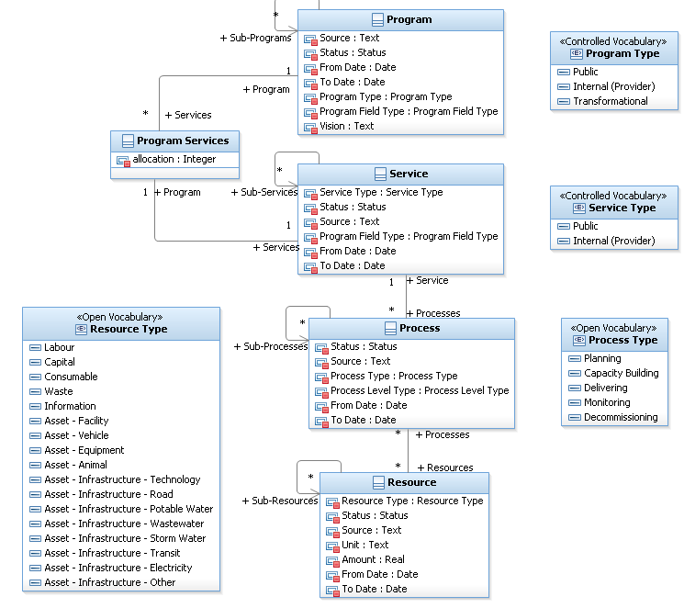
MRM Essentials

Slide 24
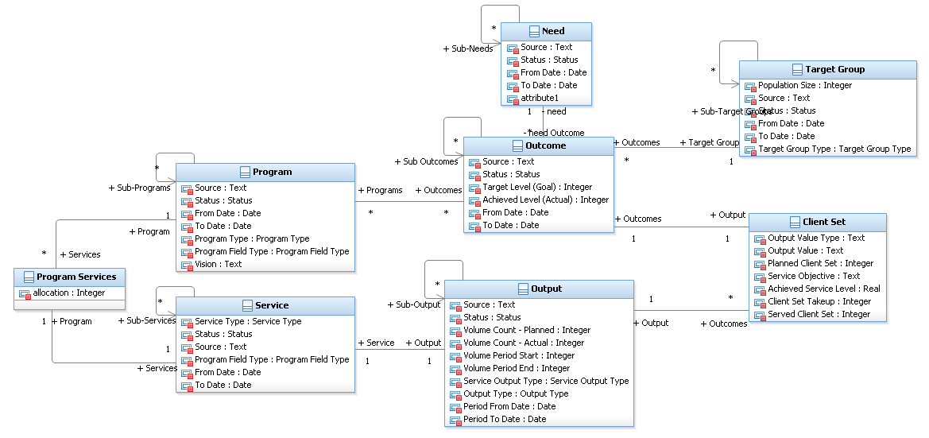
Services

Slide 25
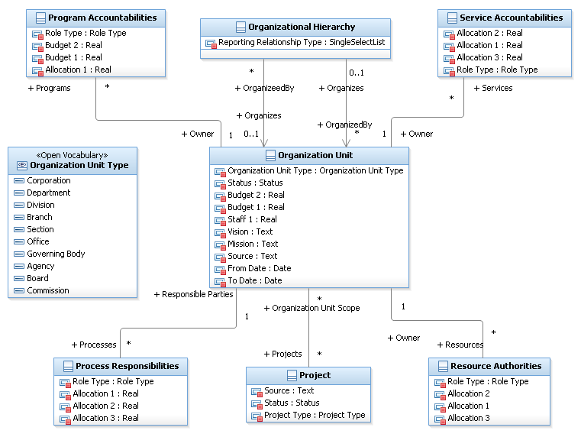
Organizational Structure

Slide 26
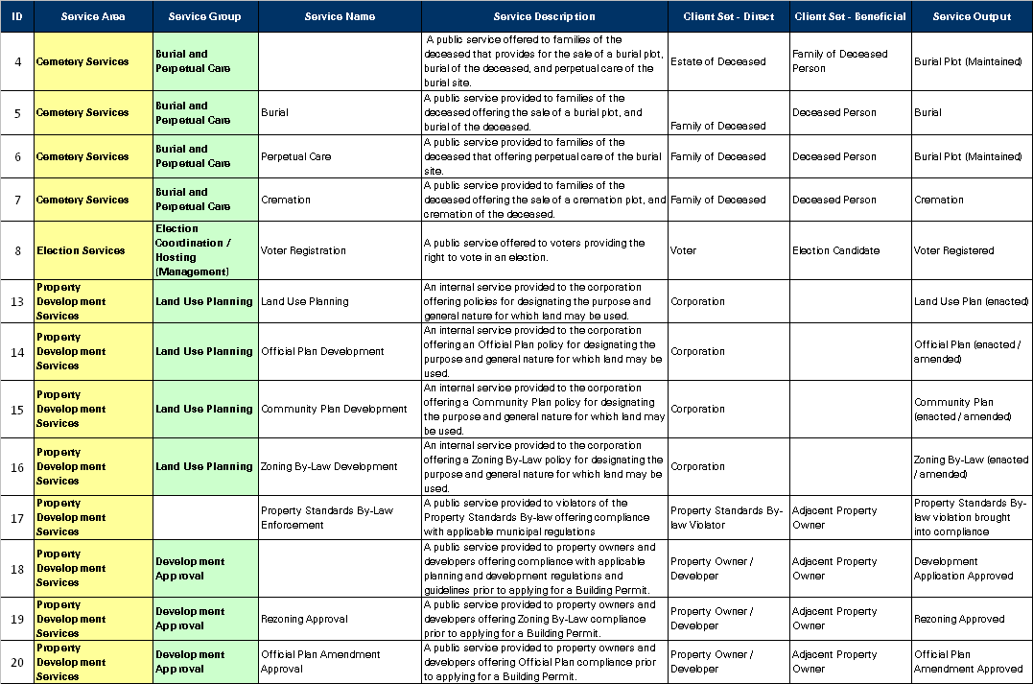
Government Reference Model Components Standard Catalog of Programs and Services
About 150 high-level municipal services; Almost 1,000 detail-level municipal services
Notes:
Sample Reference Model Services – Currently Under Development!

Slide 27
MRM Support must address some challenges
Tool Challenges
Complex, licensing initial tool and project setup
Challenges running rich client apps in a WAN
Limited or manual integration between tools
Meta-model and instance model
Model and rich text & graphics
Model and collaboration environment
Lack of data validation on import using the matrix builder
Limited support for model diagrams and/or model comparison
Limited Reporting, Querying and Scripting
Export and publish capability
Solution Issues
How to export from MISA repository into a Municipality’s design & development environment
Making the MISA models actionable
Integration with down-stream Model-Driven solutions design, implementation and deployment
Move to load and save capability instead of export/import
Reporting capabilities
Process Enablement
How to create initial municipal model
Import CSV file from existing assets
Use matrix editor to edit relationships
Frameworks for model development and use
Supporting guidebooks
How to create a municipal instance by merging multiple reference models
Need to support multiple reference models (e.g. water, transport, police, transit etc.)
Governance Challenges
Lifecycle management of meta model and reference model
Structure of the reference model given variation in service offerings by Municipality
Need to support multiple reference models (e.g. water, transport, police, transit etc.)
Lifecycle management of the municipality instance models and initial “on boarding” of subscribers
Data validation at source
Development and customization support needs including ongoing IT Service & Security Management
Notes:
See SDW Technical Challenges.doc

Slide 28
Emerging needs identified through the ITR process
Interface and tools required to support variety of role types including a non-technical user
Need for multi-classification for more flexible organization, easier search
Need for financial planning and reporting integrated with dashboard capability
Need for easy modification, lifecycle management and compare/merge of models
Need to connect policy, metrics to operational systems for feedback
Balance functionality and usability with a shared cost model
IT Service Management and Security integration
Low cost of entry for municipalities
Support for centralized License and Image management by MISA
Help and training support for municipality roles
Tool requirements will vary by municipality
Some municipalities need modeling tool, others just need access to the data to incorporate within own tools
Support both Business and IT planning including
Upstream Strategic Planning (what to do with the municipal models)
Downstream Connection to IT architecture (for solution design/development)
Business Analytics, Executive Dashboards and Business Intelligence
Notes:
Issues taken from various MISA presentations

Slide 29

IBM Rational Portfolio Management
“Making the Right Investments”
“Right Market, Right Time, Right Scope”
“Doing Things Right”
“Measure Performance Against Business Objectives”
Align investments with business objectives
Improve predictability of product success
Manage and optimize project execution
Measure team performance and project results
Plan
Deliver
Govern

Slide 30





The concepts of building a Smarter Planet, and Smarter Government, are enabled by a business infrastructure that is instrumented, interconnected, and intelligent.
Instrumented
Sensors that enable management of energy use
Management of critical equipment used in transportation, water distribution and waste disposal to prevent outages & accidents
Digital video surveillance to protect public buildings and the transportation infrastructure and to protect citizens in public areas
Real time situational awareness for military effectiveness
Interconnected
Anywhere anytime access for citizens
Dynamic information support to improve effectiveness of mobile government employees
Critical cross-agency information sharing for key decisions
Collaboration across governments and with extended community
Intelligent
Fusion and real-time analysis of information for public safety
Assessment of trends for city planning and policy development
Evaluating outcomes of social services to improve the economic welfare of citizens and the community
Fraud detection to ensure government funds are properly used
Notes:
30
How is this coming about? Our planet will continue to become more interconnected, instrumented, and more intelligent day by day. Virtually all things, processes and ways of working are becoming more intelligent in how challenges are met and problems solved--laying the foundation for Governments to respond with smart solutions and for us to become a smarter planet. The catalyst for this change is transformation of the world's infrastructure…
First, what this means: for the first time in history, almost anything can become digitally aware and interconnected. People, systems and objects can communicate in new ways….
The world is becoming instrumented. Imagine, if you can, a billion transistors for every human being. Sensors are being embedded everywhere: in cars, appliances, security cameras, roads, pipelines…even in medicine and livestock. While select systems are becoming smarter, the vast majority of the world's IT infrastructure—mobile devices, PCs, servers, data centers, software and the processes that make it all work—remain slow, inefficient and incapable of the work ahead. However, there are new computing capabilities that can literally "reinvent" existing IT properties, making them leaner, flexible, resilient and smarter. In U.S. Federal, Radio frequency identification technology is expected to grow to 120 percent by the end of fiscal year 2009, according to a report released by Reston, VA-based INPUT, a market research firm that supplies data and analysis about the government marketplace to IT contractors and government agencies.
Being connected and instrumented are not sufficient. We also have to infuse intelligence into our systems and ways of working. You can depend on new computing models to manage the massive amounts of data generated by the proliferation of end-user devices, sensors, and actuators. Combined with advanced analytics, these technologies are making us smarter. Smart governments share information from multiple sources to assess situations, make intelligent decisions and react quickly. Smarter governments must protect government information and assets by implementing a smart infrastructure with security capabilities that are integrated across the organization, yet specialized enough to address a myriad of threats.
Intelligent, Connected Digital Devices
New devices and enhancements to existing devices for a variety of applications
Embedded Software
Integrated Communications network
Integrated, IP-based network segments that parallel the electricity networking connecting in the home, the neighborhood, and up the distribution and transmission network
Using a variety of technologies and networking standards
Applications
New applications and updates to traditional legacy systems that recognize and take advantage of the smart grid
Integration platform
ESB, infrastructure that ties it all together

Slide 31

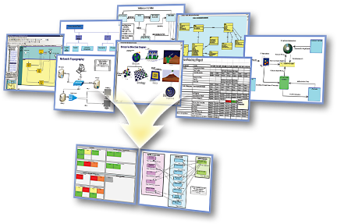
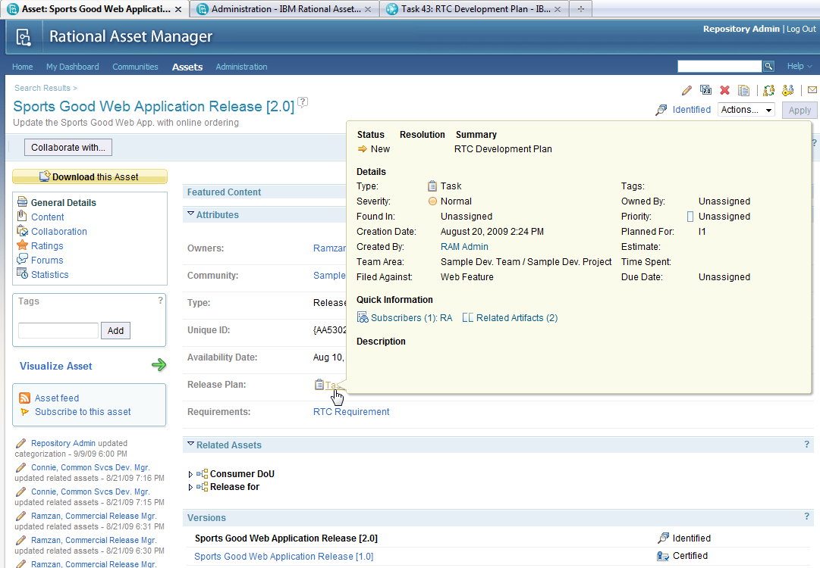




Smarter Cities closes the loop on municipal planning, solution deployment, measures and metrics with business intelligence
Municipal Reference Model
Triton Platform
Business Analytics
Asset Manager
Architect
Requirements Manager
Information Technology
Asset
Manager
Rational Software Architect
DOORS
Rational
Budgeting & Finance
Workforce/ HR
Mission Performance
Financial Performance
Jazz Platform
ClearQuest
ClearCase
Rational Team Concert
Requirements
Professional
Quality Manager
Executive Management
Operational Performance
Supply Chain
Operations/ Readiness
Program Execution
Services Delivery
Physical Meets Digital
Smarter Cities Command and Control
Operations &
Planning
Situational Views
Simulation &
Investigation
Incident Mgmt
Trends & Analysis
Cross-domain
collaboration
Live Feeds
(Sensors & Subsystems)
Notes:
Business Analytics for Municipal Government
Provides an effective means of analyzing operational information to enable effective management within the current global financial and economic environment to lay a foundation to build a better future
Enables collaboration within and across governments and target communities for policy development, planning, execution and management
Physical Meets Digital supports Smarter Cities Command and Control to automate and manage public service sub-systems using a collaborative environment that enables a city’s core systems to become smarter:
Collect, Filter and Manage the Right Kind of Data
Integrate, Analyze and Operationalize the Data
Optimize Citywide Systems to Achieve Desired Behavior
The Triton Platform can accelerate time-to-value for municipal IT solutions
What it is: “Triton” is a SWG asset from IBM providing an accelerated delivery of a SOA Foundation Infrastructure utilizing IBM Intellectual Property Assets including the Installation, Configuration and applicable implementation assets necessary to provide a fully functional SOA Foundation
What it does: Enable delivery excellence in delivering a SOA infrastructure by leveraging SOA Implementation Requirements, best practices, documentation, scripts, effectively utilizing harvested implementation assets
Why use it: To accelerate implementations (calendar and overall person/year effort) and lower risk, and leverage SOA best practices from across IBM globally.
Goal: Delivery of SOA Infrastructure Functionality (as Working Vehicle) vs, SOA “Do it yourself Kit” (Pile of Vehicle Parts & Assembly Instructions & Project Plan & Crossed Fingers & No assurance it will meet functional requirements and be delivered on time/on budget….if ever.)

Slide 32
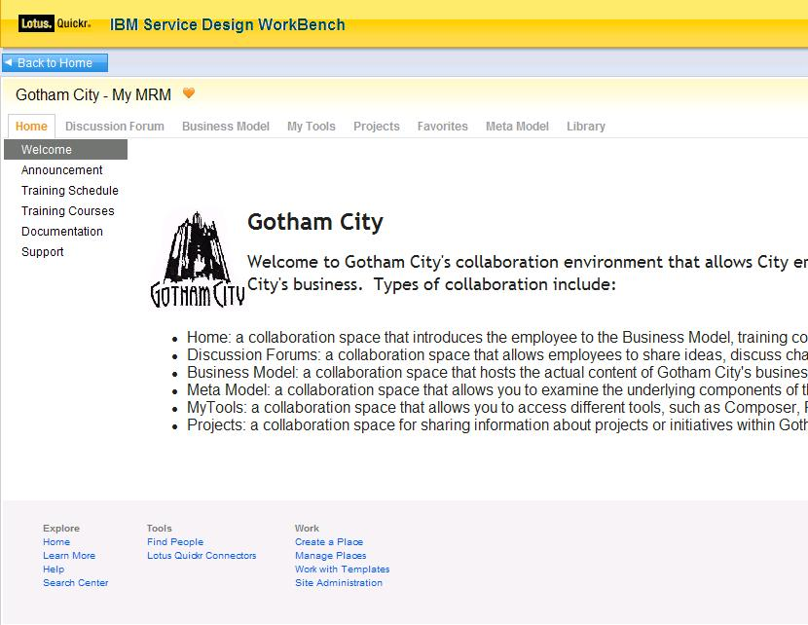
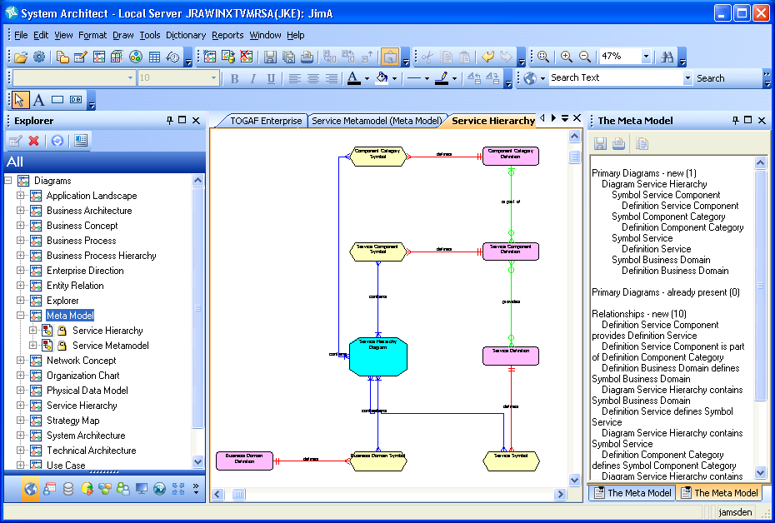
Tooling Architecture: Rational System Architect (SA) for Strategic Enterprise Planning
Business User
Business Analyst
Meta Modeler
System Architect, SA/XT, RAM, RPE
System Architect Extensibility
Lotus Quickr
Create & manage business components
Build relationships between components
Query business components
Compare business components in one municipality or across municipalities
Import/Export business component matrices
Elaborate on business components with documents, BPMN diagrams, UC diagrams
Web Interface (SA/XT)
Review business component content published from SA
Collaborate – forums, wikis
Create and extend MRM meta-model
Compare meta models (versions of one municipality or across municipalities)

Slide 33
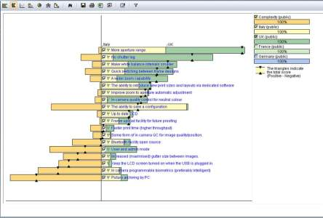
Tooling Architecture: for Municipal Strategic Planning
Business User
Business Analyst
Planner
Lotus Connections,
Optional: SA/XT
System Architect,
Optional: RAM, RPE
Focal Point
Collaborate – forums, wikis, news, defects, enhancement, etc.
Capture, validate and reason about model content
Review business component content published from SA
Optional: Review and edit Municipal Model with SA/XT
Create & manage business components
Build relationships between components
Query business components
Compare business components in one municipality or across municipalities
Import/Export business component matrices
Elaborate on business components with documents, BPMN diagrams, UC diagrams
Compare and merge content from different analysts
Perform cost/benefit analysis
Weight user importance against factors such as cost, development times, and available resources
Build, buy, or outsource decision
Optimize program and asset operations/maintenance
Notes:
Business User Artefacts:
Login/Registration
Home, News, Reference Material, Contacts, Help pages
Discussion Forum
MRM browse, municipal model browse/update
Change Requests page
Business Analysts
MRM access and municipal model access and update
Business Model Report
Program Profile Report
Service Profile Report
SIAM Diagram
Hierarchy Diagrams
Relationship Matrices
Stakeholder-specific Browsers
Planner
Project portfolio
Strategic alignment analysis
Risks, costs, time to value,
Payback Period
Project roadmapping

Slide 34

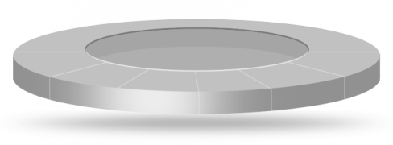
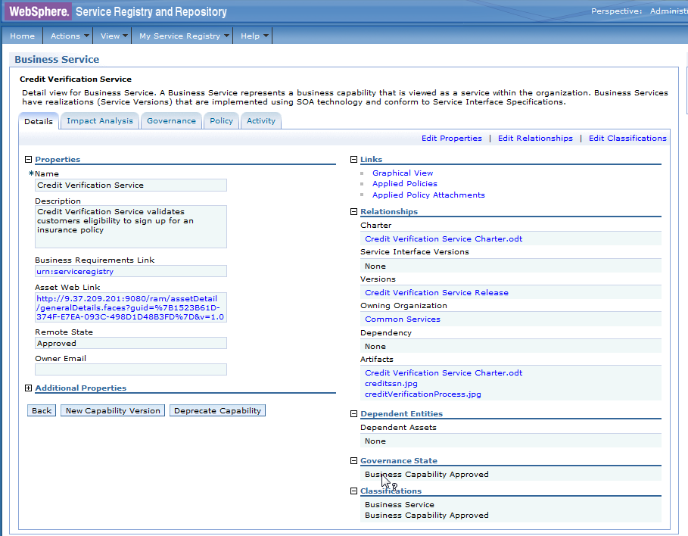

Tooling Architecture: for MRM Governance and Evolution
Business Analyst
Asset Manager
Meta Modeler
System Architect,
Optional: RPE
Optional: RAM
System Architect Extensibility
Govern and maintain the reference model
Compare business components in one municipality or across municipalities
Import/Export business component matrices
Compare and merge models (versions of one municipality or across municipalities)
Publish reference models for reuse
Artifact catalog with standard asset descriptions, variability instantiation, express intent and value proposition
Traceability between assets and to origin
Approval lifecycle
Artifact packaging, versioning, access control, tracking
Collaboration – notifications, approvals, forums, milestones, etc.
Create and extend MRM meta-model
Compare meta models (versions of one municipality or across municipalities)
Create stakeholder viewpoints and work products

Slide 35

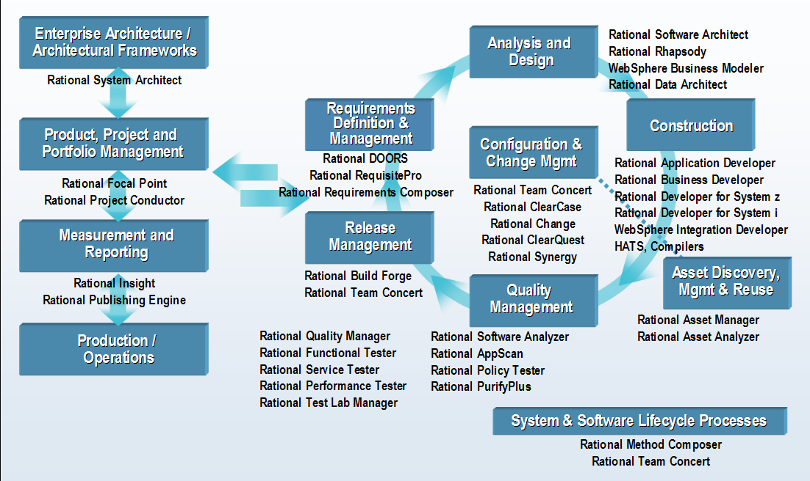
Rational System Architect (SA) based to support Municipal Architecture
Rational System Architect XT (web based)
35

Slide 36



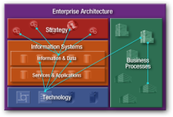

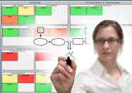

Actionable enterprise architecture Rational System Architect
Resources and costs
Strategy
Architect the Enterprise
Enterprise Reporting / Impact Analysis
Change / Transformation Implementation
Business
Link Business / IT Perspective
Cost Cutting
Optimized Solution / IT Planning
Information Systems
Harvest Enterprise Information
Consolidation Planning
Business and Technology Impact
Technology
Architecture Vision
Business
and IT Architectures
Opportunities and Solutions
Solution Planning
Solution Implementation and Governance
Notes:
IBM’s Actionable Enterprise Architecture strategy is based on the concept of taking the foundations of Enterprise Architecture, and making the results and deliverables relevant to all areas of the business.
The concept starts out with capturing and modeling all areas of the organizations, whether harvested from existing data sources, or manually captured or drawn. All organization information can be broken into four key domains:
Strategy – An organizations strategy is driven by the executive direction, commonly captured in dispersed documents or financial statements. These are the missions, goals, strategies and tactics guiding the direction of the business. This information is often difficult to directly drive enterprise action, but when built as the foundation of the enterprise architecture, strategy becomes the leading governance factor of enterprise action.
Business – The business processes depict the human functions we carry out in our daily roles. For example, a process model of a call center employee would capture the flow of actions that person carries out, including receiving a call, documenting the call details, making decisions about how to respond to the request, and finally walking the caller through the problem resolution.
Information Systems – This involves the modeling of all information systems of an organization, including applications, information/data, software, services, etc. This is important part of architecture because we can detail and understand the information systems that support business process and strategy.
Finally, The technology domain includes all of the hardware that host the information systems in the organization.
By HARVESTING this information, we are ARCHITECTING THE ENTERPRISE creating a blueprint of all four of these domains. Organizations LINK THE BUSINESS / IT PERSPECIVE by creating relationships of a business processes and strategy in the context of the rest of the enterprise systems (e.g., data architecture, organizational structure, strategies, etc.) and create greater capabilities when analyzing and planning enterprise changes (ENTERPRISE REPORTING / IMPACT ANALYSIS).
For example, during a corporate merger it is important to understand the processes of both companies in detail so that management can correctly and efficiently identify and eliminate redundancies in operations. (COST CUTTING , CONSOLIDATION PLANNING).
This leads to greater success when implementing NEW SOLUTIONS, planning BUSINESS TRANSFORMATION, or IT PLANNING.

Slide 37
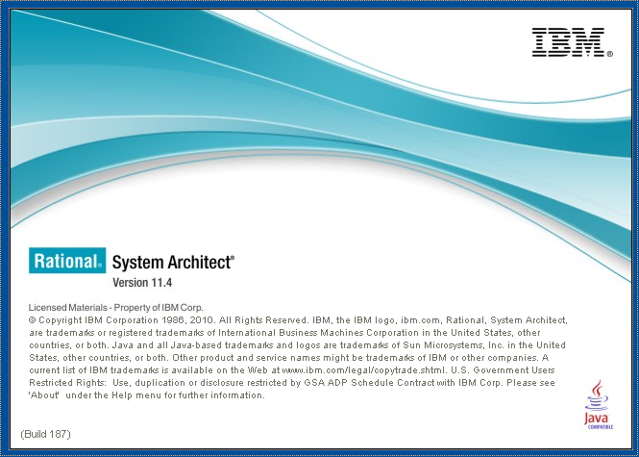
Business Analyst launch screen for Program and Service definition

Slide 38
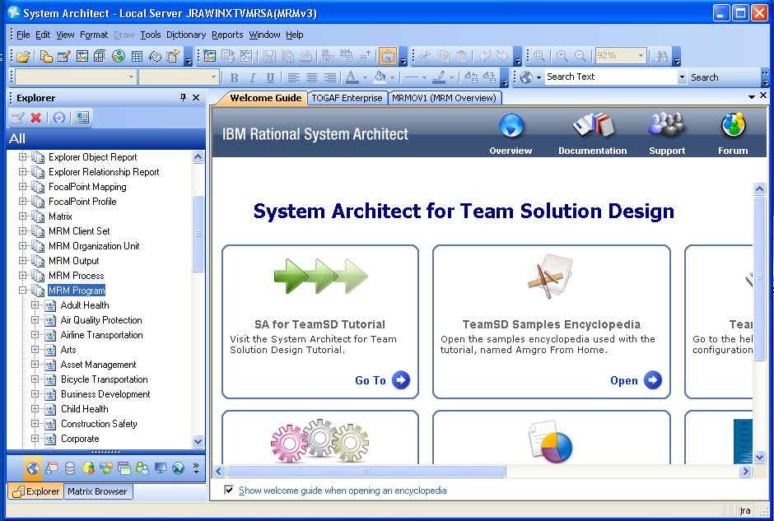
Guide Books can provide tool mentors and automation
Notes:
Browsers can be used to organize model content for different stakeholder needs.
The image also shows a partial list of MRM programs.

Slide 39
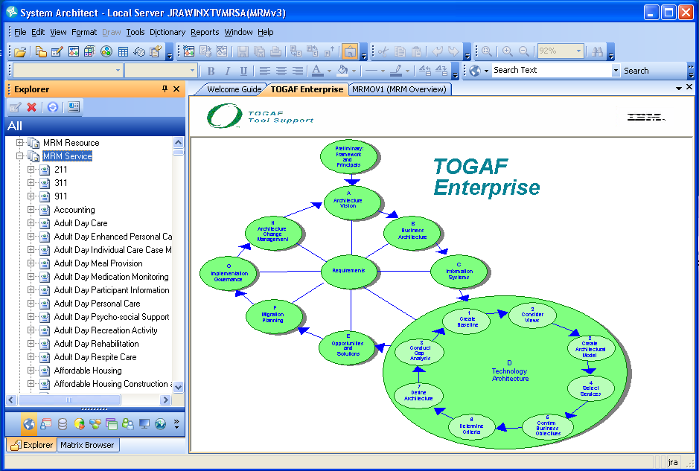
A Framework can support use of MRM
Notes:
The image also shows a partial list of MRM services.

Slide 40
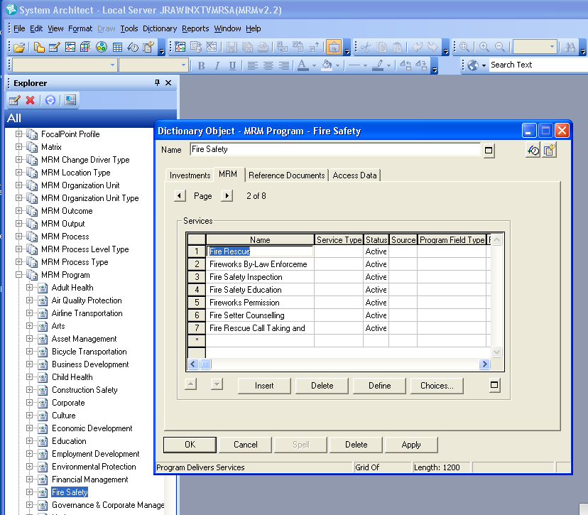
Select a Program and show Services associated

Slide 41
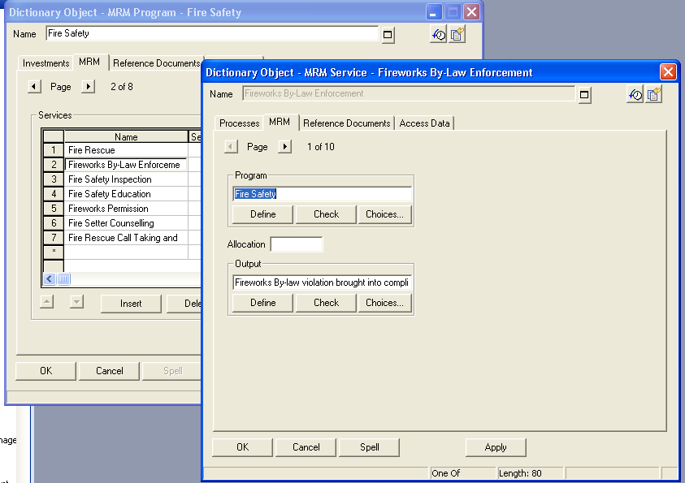
Select a Service and display attributes

Slide 42
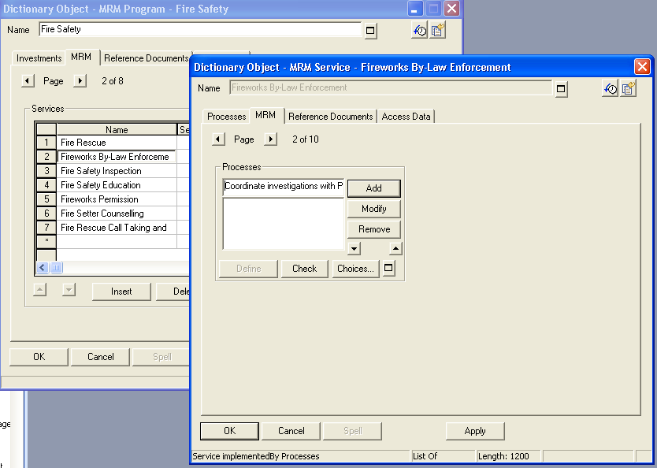
The Business Analyst is able to create a procedure (wizard driven and user intuitive)
Notes:
New processes can be added from the Explorer, or from the related element directly.

Slide 43
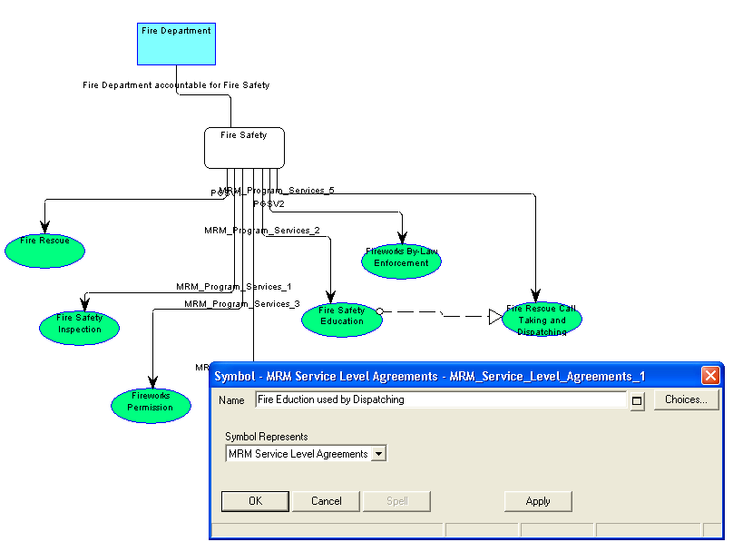
Once the Business Analyst has defined the Service and Process they can set / revise the Service level specification

Slide 44
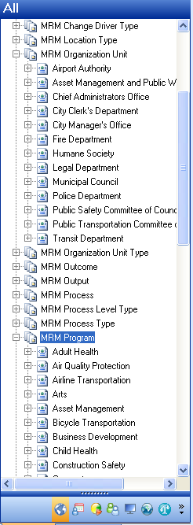
Each project is organized in an intuitive tree structure

Slide 45
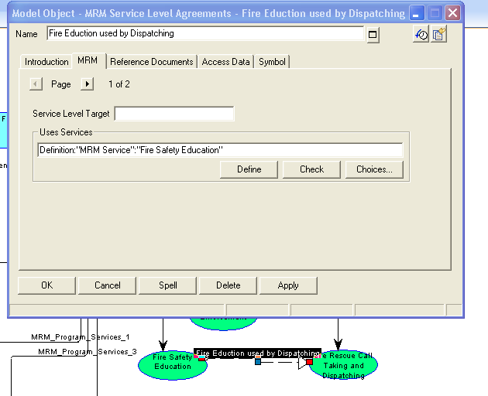
All records in the service specification interface can be parameterized – here are Smallville’s organizations

Slide 46
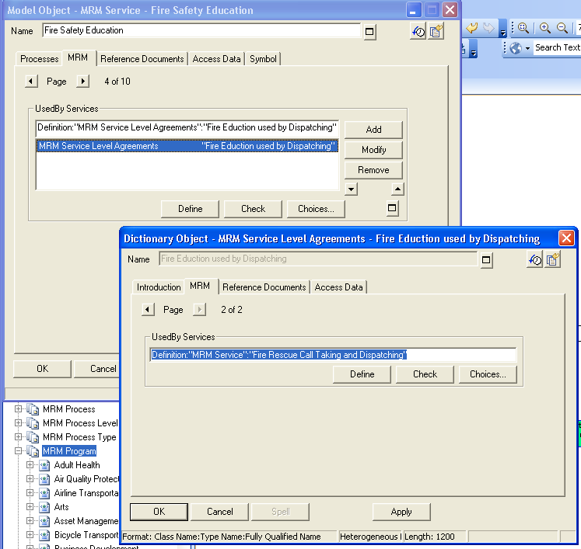
Setting parameter values is as simple as opening the definition from any reference

Slide 47
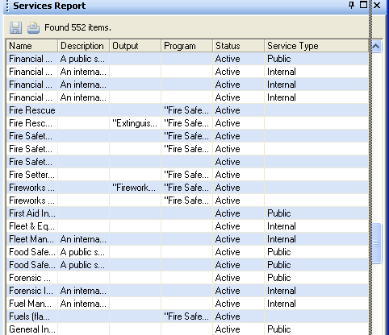
Smallville’s parameterized services – all this data is available for sorting, querying, and reporting

Slide 48
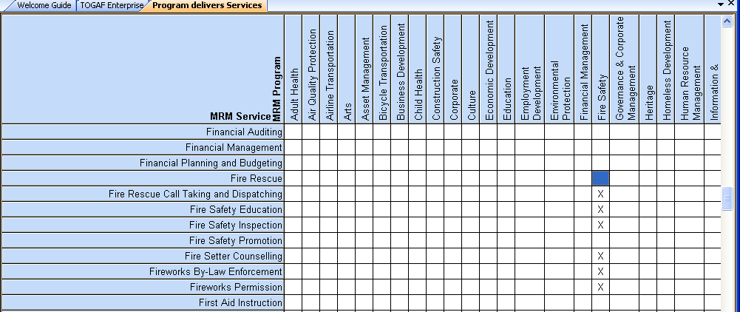
Services (in rows) has cross referenced traceability with Programs (columns) that deliver them

Slide 49
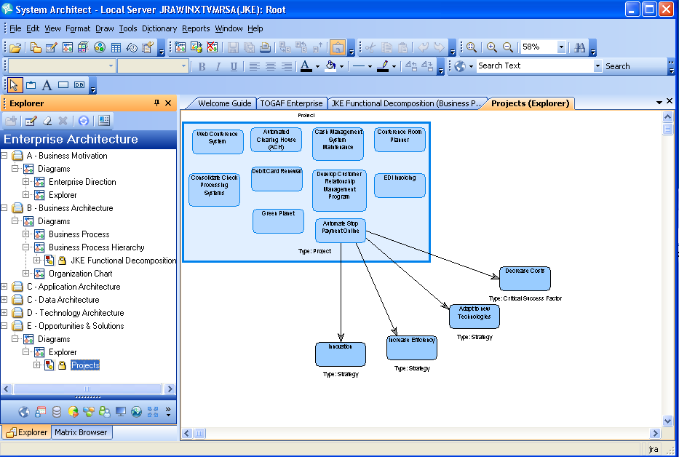
Explorer diagrams support impact analysis

Slide 50
Assessment
Supports Enterprise Strategic planning not just Model Driven Development
Meta-model and models are in a single tool
Supports lifecycle management through workspaces
Integrates with Focal Point for strategic planning
Integrates with Cognos for Business Intelligence
Supports explorer, data forms, diagram and matrix views
SA/XT provides Web interface with limited editing capability
Powerful, flexible query mechanism, explorer diagrams and reporting
Highly customizable for stakeholder viewpoints
Supports model compare/merge
Provides support for enterprise architecture including business and IT architecture for solution design
Good solution if strategic planning is the primary value proposition
Future support for semantic web
Integrated Guidebooks and help
Notes:
+ SA has a rich client UI, and a Web UI using SA/XT that also supports model editing
+ SA supports integrated explorer, data entry form, diagram and matrix views on model data as well as free-form views
+ SA provides rich, extensible matrix views and additional views can be created by end users in support of particular stakeholder needs
+ SA is highly customizable even by end users (for opportunistic metamodel extensions)
+ SA has a powerful, flexible query mechanism
+ The supporting tool set is resulting in the installation of less tools (SA and SA/XT)
+ Information is integrated into a single repository accessed by different tools reducing lifecycle management burden and costs
+ Lifecycle management is supported by workspaces and compare merge of model content
+ Information redundancy can be managed as needed
+ The MRM business motivation and strategy, and business architecture parts of EA can be easily extended or integrated with other content and capabilities to support the rest of the EA (application, data and technical architectures) for the next phase of use cases
- Editing the metamodel with SA USERPROPS is not as easy as editing a UML model. This may be improved in 11.4.1 with the introduction of a metmodel editor extension to visually create the metamodel extensions. (That capability may be available for internal use now).
+ Metamodel extensibility includes support for explorers, forms, matrixes, diagrams and reports, not just the metamodel classes
+ SA has a number of different reporting options that can be used
+ SA/XT can be integrated with Quickr to provide collaboration on live MRM data, not just published, potentially stale data
- SA rich client UI may not be appropriate for many business analysts and SA/XT has limited editing capabilities
+ SA integration with Focal Point would provide a capability to objectively analyze different MRM project alternatives
+ Some elements of the existing SA TOGAF and/or TeamSD metamodels could be used to enhance and extend the existing MRM metamodel and tools, as well as address more of the MRM business use cases.
- No support for sketching and storyboards directly in SA

Slide 51
Addressing the Issues
Issue | Addressed By
Complex, licensing initial tool and project setup | Reduction in number of tools. SA replaces RSM, ReqPro and RRC
Challenges running rich client apps in a WAN | Same problem with all options. SA runs in Remote Desktop Connection with floating license
Limited or manual integration between tools Meta-model and instance model Model and rich text & graphics Model and collaboration environment | All models in SA. SA extensibility used to update metamodel. SA and SA/XT used to view and edit models. Uses SA browser, definitions, diagrams, matrices, explorer diagrams
Lack of data validation on import | Eliminate as much as possible import/export as a means of integrating tools
Limited support for model diagrams | SA has support for many standard diagrams, explorer diagrams (from reports) and can have custom diagrams
Limited Reporting, Querying and Scripting | SA supports queries, HTML and Office reports, SA Publisher, Insight and Cognos reporting, and RPE

Slide 52
Addressing the Issues (cont.-)
Issue | Addressed By
Interface suitable to different stakeholders | SA rich client for business architect, SA/XT for business architect and user, Quickr for collaboration
Support for flexible classification | SA supports categorization of model elements, and/or use RAM
Strategic Planning | SA integration with Focal Point provides: Project Portfolio Management Strategic alignment with business objectives Assessment of costs, risks, NPV, time to value Project roadmaps and resource allocation
LIfecycle Management | SA has versioning for definitions, and workspaces for different work streams. Supports compare and merge to manage changes. RAM for asset management and governance
Cost | Incremental difference in cost for each solution option. Actual cost depends on potential use of Cloud subscription model. Needs further investigation
Availability | Existing solution would need to be migrated to chosen option

Slide 53
Alignment with other initiatives
MISA Municipal Reference Model
Physical Meets Digital-Physical Infrastructure (PMD-PI) for Smarter cities EA: This is essentially a technical architecture based on the Triton platform for collecting, analyzing, reporting and acting on real-time municipal information in support of municipal operations. Chris O'Connon
Cognos Performance Management Expert applied to Municipal Performance Management: Could be seen as component of the PMD-DI for bottom-up BI input into strategic planning driven by operational data.
Actionable Smarter Cities: A combination engagement method and platform for municipal strategic planning and operational support that combines some of the above. Based on CBMSOMA method and tools, feeding into WBM and SA based on GBS Actionable Business Architecture strategy. Essentially a method and supporting tools for a BPM-centric architectural style, technical architecture, and target platform. Also uses Cognos for BI.
Multi-Agent Accelerator, David Conh, creating a cloud based hub of services that can be composed into a relevant set of services.
Cause effect graph
Notes:
1. MISA Municipal Reference Model: This is a service-oriented Domain-Specific Language for defining municipal programs, services, processes and resource; and a reference model that uses this metamodel to define best practices and useful content as a starting point for municipal transition initiatives. It is essentially a reference model for a business architecture in the domain of municipal services. MRM would be used primarily for top-down strategic planning.
2. Physical Meets Digital-Physical Infrastructure (PMD-PI) for Smarter cities EA: This is essentially a technical architecture based on the Triton platform for collecting, analyzing, reporting and acting on real-time municipal information in support of municipal operations. Chris O'Connon
3. Cognos Performance Management Expert applied to Municipal Performance Management: Could be seen as component of the PMD-DI for bottom-up BI input into strategic planning driven by operational data.
4. Actionable Smarter Cities: A combination engagement method and platform for municipal strategic planning and operational support that combines some of the above. Based on CBMSOMA method and tools, feeding into WBM and SA based on GBS Actionable Business Architecture strategy. Essentially a method and supporting tools for a BPM-centric architectural style, technical architecture, and target platform. Also uses Cognos for BI.
5. Multi-Agent Accelerator, David Conh, creating a cloud based hub of services that can be composed into a relevant set of services.
6. Cause effect graph

Slide 54
Linking Strategy to Execution
Product
Portfolio
Management
Product Management
Project
Management
Strategic
Tactical
Governance
Are products ALIGNED with our strategy?
Do we have the right BALANCE of risk/reward?
Are products delivering the expected VALUE?
Are we doing the RIGHT products?
Are we investing in the RIGHT areas?
Do we have the RIGHT types resources available?
Doing projects well
Delivering results on time and budget
Enhancing communication and productivity
Notes:
Focal Point was designed to bring the three elements of successful product leadership together… product management, requirements management and product portfolio management.
Successful product management is a function where strategic planning and market analysis, as well as tactical execution, are critical success factors. Unfortunately, research indicates that Product Managers spend more than 80% of their time on tactical activities and sales support. Additionally, 93% of Product Managers feel they spend far too much time answering basic questions for sales, and 72% feel they are not used effectively as a sales support resource
The role of Focal Point Focus on Product Management is to help product managers automate the tactical activities that consume most of their time and prevent them from doing the strategic activities that help them deliver successful products.

Slide 55
Next Steps
Maintain current Quickr deployment for collaboration
MISA team to validate structure and configuration parameters to support the pilot
Complete MRM implementation in SA
MISA team to finalize the meta-model and list of work products
MISA team to finalize the Reference Model (s) to be used by the pilot
May wish to include multiple reference models and exploit merge capability
IBM Team to determine scope of work and estimate of effort to implement the Meta Model, Reference and work products sufficient to support MISA pilot projects
Review the Ontario Public Service GSDC System Architect deployment & Meta Model (July 22)
IBM to determine migration of current licenses to Rational System Architect option
Team to investigate what other tools maybe required given measurement and reporting functional requirements
For example the addition of Rational Focal Point, Insight and/or Web based Rational System Architect XT
Investigate further alternate delivery model for access to tools
IBM to arrange a workshop and presentation of the Cloud Burst toolkit and Rational Asset Manager to support potential for future tool provisioning based on an desktop image catalog
Investigate opportunity to build MISA Industry Plug-in
Initial recommendation is to investigate support for both modeling & planning tools and Business Intelligence/Analytics tools
IBM Team to talk with Jim Alexander regarding target governance model
IBM Team to coordinate with Bob Dill for overall Smarter Cities strategy
Including possible new business transformations

Slide 56
Appendix

Slide 57
MISA Meta Model Business Components
Entities and Attributes
Program=PG
Service=SV
Organizational Unit=OU
Process=PR
Performance Indicator=PI
Project=PJ
Outcome=OC
Need=NE
Target Group=TG
Resource=RE
output=OP
Location=LC
Change Driver=CD
Business Process=BP
Relationships
Project Program Scope=PJPG
Program Outcomes=PGOC
Program Services=PGSV
Program Accountabilities=PGOU
Program Hierarchy=PGPGHI
Program Performance=PGPI
Program Impacts=PGCD
Service Level Agreements=SVSVSLA
Service Hierarchy=SVSVHI
Service Processes=SVPR
Service Outputs=SVOP
Service Accountabilities=SVOU
Service Performance=SVPI
Service Impacts=SVCD
Project Service Scope=PJSV
Client Set=OPOC
Process Impacts=PRCD
Process Resources=PRRE
Process Hierarchy=PRPRHI
Process Performances=PRPI
Process Responsibilities=PROU
Process Outputs=PROP
Relationships cont.
Process Sequence=PRSQ
Project Process Scope=PJPR
Business Process Composition=BPPR
Resource Hierarchy=REREHI
Resource Impacts=RECD
Resource Performance=REPI
Resource Authorities=REOU
Project Resource Scope=PJRE
Project Organization Scope=PJOU
Organizational Hierarchy=OUOUHI
Target Group Outcomes=TGOC
Need Outcomes=NEOC
Output Composition=OPOPHI
Needs Hierarchy=NENEHI
Target Group Hierarchy=TGTGHI
Resource Location=RELC
Service Location=SVLC
Organization Location=OULC
Outcome Hierarchy=OCOCHI
Municipal Reference Model (MRM) Version 2 (V2) – Release 1 Business Use Cases, Tasks, Operations, Features
and Meta Model Specifications V19, December 2009

Slide 58
Government of Ontario GO-ITS Standard 56 V 1.5 (May 2010) - Artefacts
Resource Type
Line of Business Profile
Program
Service
Program Profile
Location Type
Geographical Area Type
Party Type
Role Type
Target Group Type
Event Type
Cycle Type
Goal
Need
Mandate (Program)
Strategy
Target Group / Need Cross Ref
Program/Service Cross Ref
Conceptual Data Model
Information Model
Semantic Model
Fact and Dimension Matrix
Interface Data Requirements Document
Service Life Cycle
Business Function Model
Service Integration and Accountability Model
Service Profile
Business Process Model
SOA Service Description Profile
Business Network Model
Governance Model
Organization Chart
State Transition Diagram
Business Scenario
Service Objectives
Performance Matrix
Business Rule Source
Business Rule Profile
Program Logic Model

Slide 59
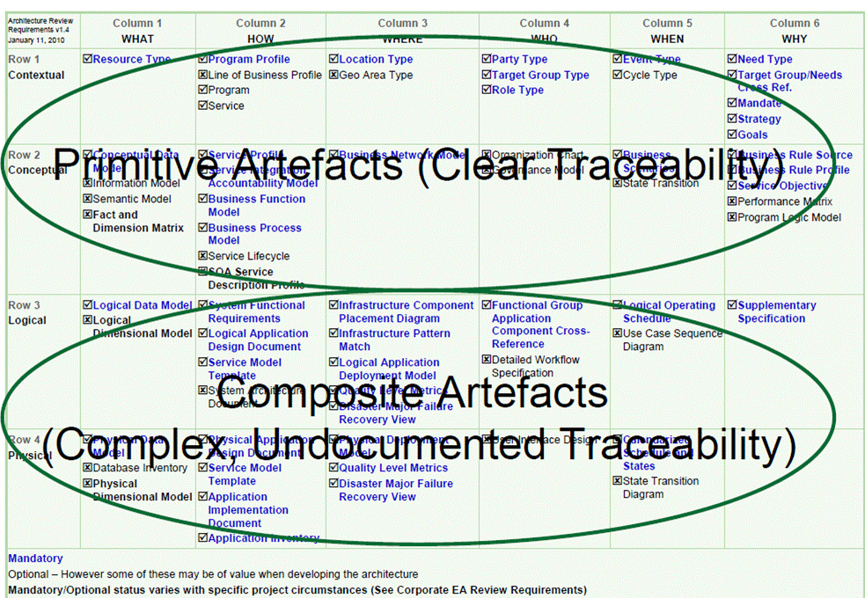
Government of Ontario GO-ITS Standard 56 V 1.5 (May 2010) - Artefacts

Slide 60
Integrated Technical Review (ITR) Approach
Business Direction/Drivers
Review original RFI and the subsequent IBVA
Determine stakeholder roles and objectives
MISA
IBM (e.g. MISA plug-in options within IBM tools)
MISA Subscribers (municipalities)
Review Functional Requirements Matrix
Municipal Reference Model (MRM), V2-Rel 1 Business Use Cases, Tasks, Operations, Features and Meta Model Specifications (Draft V19, Dec 2009)
Best Practice/Assets types
Assess Use Case (s) and solution options
IBVA Business Use Cases (approx. 5)
System Use Cases / Task Specifications (approx. 21)
Other?
Understand other requirements and activity
Scripting and reporting needs
Non-Functional requirements
Standards
Address Pilot and Tool Concerns documented
June 25, 2010 email including SDW Technical Challenges document and MRMv2 Functional and Technical Requirements document

Slide 61
The Municipal Reference Model Version 2 (MRM v2)
Project Milestones
June 2006: MISA/ASIM Canada Board approves initiation of MRMv2 Project. Assigns responsibility to MISA Ontario to execute/lead project.
November 2007: RFI issued to vendor community seeking MRMv2 solution consisting of four components: 1. MRM in modeling tool; 2. End user software tool; 3. MRM website and 4. Training material and course delivery
January 2008: Four responses received to RFI, including IBM
July 2008: Steering Committee approves decision to proceed with IBM proposal and to initiate Business Value Assessment with IBM to further confirm market potential and business requirements
August 2008: MISA conducts series of webinars promoting the MRM and reflecting real-life experience in Saint John, Windsor and Toronto
September-October 2008: IBM and MISA team conduct in-person interviews with municipalities across the country as part of IBVA process

Slide 62
The Municipal Reference Model Version 2 (MRM v2)
Project Milestones (Continued)
January 2009: IBVA Report Complete, substantial municipal interest confirmed from across the country. IBM presents “proof of concept” illustrating how RFI objectives can be delivered using IBM tools.
April 2009: MISA/IBM negotiate framework for IBM participation in MRMv2
May 2009: Start detail design with the City of Toronto Process initiated to raise the required funds from municipalities known to be interested.
October, 2009: MISA enters into Agreement with IBM to develop MRMv2 solution
Negotiating parallel relationship agreement with KPMG to provide advisory services
$325,000 raised from municipalities for MRMv2 program
Prototype solution approved by Steering Committee
December 2009: Basic design complete
Tool to be piloted by four municipalities
Full release scheduled for mid-2010

Slide 63
IBVA Process and Objectives
MISA requested information to satisfy four major needs:
MRM Reference Model Meta Model in Modeling Tool
MRM End User Tool
MRM Web Site
MRM Training (Training Material and Course Delivery)
IBM proposed an Industry Business Value Assessment as a first step
Stage 1 – Planning and Design Verification
Phase 1 – Planning
Phase 2 – Validate MRM Meta Model and Repository Design
Stage 2 – Detailed Design, Build and Train
Phase 3 – Detailed End-to-End Design
Phase 4 – Build MRM Tooling
Phase 5 – MISA End User Training
Stage 3 – Pilot and Evaluation
Phase 6 – Model the Pilot Service
Phase 7 – Lessons Learned Checkpoint
IBVA as time-boxed planning study:
Business needs / use cases
Platform alternatives and options
Business value
Demonstrations
Design and deployment
Project proposals / plans
Detailed design models
Structuring and relations between (meta-)models
Notes:
63
Background
Municipal Reference Model (MRM)
Services Mapping in Municipalities – Examples
City of Brantford City of Brockville City of Burlington
City of Calgary City of Coquitlam City of Etobicoke
City of Fredericton City of Guelph Haldimand-Norfolk
City of Halifax Halton Region Hamilton-Wentworth
City of Kitchener City of London Town of Markham
City of Mississauga City of Oshawa City of Ottawa
Ottawa-Carleton Peel Region City of Scarborough
City of Surrey City of Thunder Bay City of Timmins
Metro Toronto City of Waterloo City of Winnipeg
York Region County of Oakland County of Washtenaw
City of Phoenix City of Shanghai

Slide 64
IBVA Findings: Needs and Business Value
Mentions | Need | Business Value
10 | Reorient from department to service | Clear responsibilities, accountabilities
10 | Comparisons across jurisdictions | Like offerings (e.g. have transit or not)
10 | Business intelligence across departments | Foresight on impact of policy changes
9 | Service profiles, budget profiles, processes | Deliver services rather than just activities
9 | Get ideas on improvements | Learn from leaders (e.g. London, UK)
9 | Common vocabulary, terms and conditions | Consistent language across jurisdictions
8 | Service-based budgeting | Knowing cost of performance, not volume
8 | Not just current, but future orientation | Planning for growth / pandemics
8 | Appreciate cross-jurisdictional differences | Recognize mapping / concordance / crosswalk with other jurisdictions
8 | Engage community with plans | Tying services to program outcomes
8 | Reconcile public terms and professional terms | Link with formal bodies (e.g. OMBI, ITIL, CobiT, National Transportation Council)
8 | Streamlining and separating workflows | Structural changes, amalgamating,
Notes:
64
Background
Municipal Reference Model (MRM)
Services Mapping in Municipalities – Examples
City of Brantford City of Brockville City of Burlington
City of Calgary City of Coquitlam City of Etobicoke
City of Fredericton City of Guelph Haldimand-Norfolk
City of Halifax Halton Region Hamilton-Wentworth
City of Kitchener City of London Town of Markham
City of Mississauga City of Oshawa City of Ottawa
Ottawa-Carleton Peel Region City of Scarborough
City of Surrey City of Thunder Bay City of Timmins
Metro Toronto City of Waterloo City of Winnipeg
York Region County of Oakland County of Washtenaw
City of Phoenix City of Shanghai

Slide 65
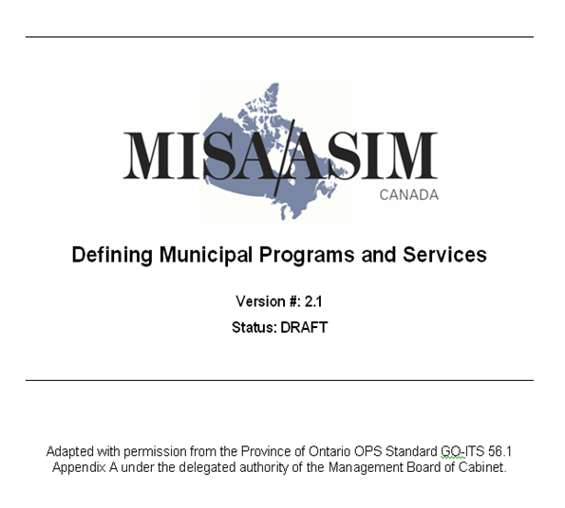
Documentation/Starter Kit
Business User Handbook
How to get started applying the MRM to a business challenge
MRM primer
Guide to each Business Use Case, including typical analytic reports and purpose
Navigating the Quickr Interface
Business Analyst Handbook
Guide to the use of the MDW Tools
Guide to the preparation and publishing of standard reports by Use Case and Task Specification
Guide to the extension of the local business model to address custom requirements
Administrator’s Handbook
Guide to setting up the MRM toolset and user projects and permissions
Meta Modeler Rules
Guide to making changes to the local copy of the MRMv2 Meta Model
Notes:
Handbook update

Slide 66
Positioning the Municipal Reference Model v2… a “game-changing” framework for smarter cities, smarter jurisdictions, smarter communities
smart
planet
smarter
communities
smarter
jurisdictions
smarter
cities
smarter
services
MRM
… a key enabler for smarter transitions
by supporting multiple on-ramps

Slide 67
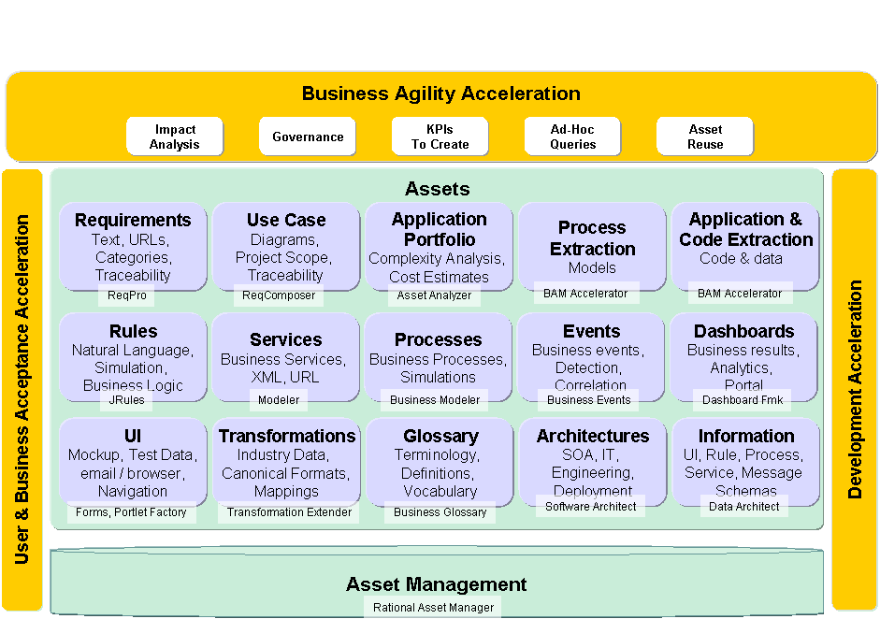
Recent IBM announcement - Smarter Architecture & Engineering Solution to support Model Driven Development
Notes:
ReqPro & Requirements Composer
This “Must” …
Links to other assets
Asset Management Repository
Taxonomy
Search
Report
Governance
Software Architect
Business Architecture
UML
Traceability
Modeler
Business Processes
Publishing Server
Simulator
Business Rules
Externalize Logic
Rules Server
Forms
Email UI to Users
Integrate with Web 2.0 and Portal
Portlet Factory
Assemble Forms and Portlets
Business Events
What happens over time?
Visual Portlets
Business Spaces
Integrates UI for Business Architecture
Runtime Results
Iwidgets
Data Architect
Logical Information Model
Asset Analyzer
Legacy analysis
Complexity Analysis

